Slide 1
Condition
Session 5

Slide 2
Objectives
Explain the Selection Construct
- If Statement
- If – else statement
- Multi if statement
- Nested if statement
Switch statement

Slide 3
Conditional Statement
Conditional statements enable us to change the flow of the program
A conditional statement evaluates to either a true or a false value
Example :
To find whether a number is even or odd we proceed as follows :
Accept a number
Find the remainder by dividing the number by 2
If the remainder is zero, the number is “EVEN”
Or if the remainder is not zero the number is “ODD”

Slide 4
Selection Constructs
C supports two types of selection statements
The if statement
The switch statement

Slide 5

The if statement-1
Syntax:
If the if expression evaluates to true, the block following the if statement or statements are executed

Slide 6
The if statement-2
#include <stdio.h>
void main()
{
int x, y;
char a = ‘y’;
x = y = 0;
if (a == ‘y’)
{
x += 5;
printf(“The numbers are %d and \t%d”, x, y);
}
}
Program to display the values based on a condition
Example

Slide 7
The if – else statement-1
Syntax:

Slide 8
The if – else statement-2
If the if expression evaluates to true, the block
following the if statement or statements are
executed
If the if expression does not evaluate to true then the statements following the else expression take over control
The else statement is optional. It is used only if a
statement or a sequence of statements are to be
executed in case the if expression evaluates to false

Slide 9
The if – else statement -3
Program to display whether a number is Even or Odd
#include <stdio.h>
void main()
{
int num , res ;
printf(“Enter a number :”);
scanf(“%d”,&num);
res = num % 2;
if (res == 0)
printf(“Then number is Even”);
else
printf(“The number is Odd”);
}
Example

Slide 10
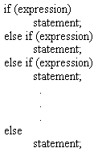
The if–else–if statement-1
Syntax:

Slide 11
The if–else–if statement-2
The if – else – if statement is also known as the if-else-if ladder or the if-else-if staircase
The conditions are evaluated from the top downwards

Slide 12
The if–else–if statement-3
Program to display a message based on a value
#include <stdio.h>
main()
{
int x;
x = 0;
clrscr ();
printf(“Enter Choice (1 - 3) : “);
scanf(“%d”, &x);
if (x == 1)
printf (“\nChoice is 1”);
else if ( x == 2)
printf (“\nChoice is 2”);
else if ( x == 3)
printf (“\nChoice is 3”);
else
printf (“\nInvalid Choice “);
}
Example

Slide 13
Nested if-1
The nested if is an if statement, which is placed
within another if or else
In C, an else statement always refers to the
nearest if statement that is within the same
block as the else statement and is not already
associated with an if

Slide 14
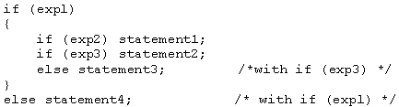
Nested if-2
Syntax:
Note that the inner else is associated with if(exp3)
According to ANSI standards, a compiler should
support at least 15 levels of nesting

Slide 15
Nested if-3
#include <stdio.h>
void main ()
{
int x, y;
x = y = 0;
clrscr ();
printf (“Enter Choice (1 - 3) : “);
scanf (“%d”, &x);
if (x == 1)
{
printf(“\nEnter value for y (1 - 5) : “);
scanf (“%d”, &y);
if (y <= 5)
printf(“\nThe value for y is : %d”, y);
else
printf(“\nThe value of y exceeds 5 “);
}
else
printf (“\nChoice entered was not 1”);
}
Example

Slide 16
The switch statement-1
The switch statement is a multi-way decision maker that tests the value of an expression against a list of integers or character constants
When a match is found, the statements associated
with that constant are executed

Slide 17
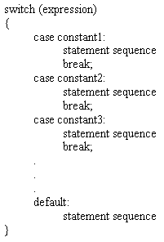
The switch statement-2
Syntax:

Slide 18
The switch statement-3
Program to check whether the entered lowercase character is vowel
or ‘z’ or a consonant
#include <stdio.h>
main ()
{
char ch;
clrscr ();
printf (“\nEnter a lower cased alphabet (a - z) : “);
scanf(“%c”, &ch);
contd…….
Example

Slide 19
The switch statement-4
if (ch < ‘a’ || ch > ‘z’)
printf(“\nCharacter not a lower cased alphabet”);
else
switch (ch)
{
case ‘a’ :
case ‘e’ :
case ‘i’ :
case ‘o’ :
case ‘u’ :
printf(“\nCharacter is a vowel”);
break;
case ‘z’ :
printf (“\nLast Alphabet (z) was entered”);
break;
default :
printf(“\nCharacter is a consonant”);
break;
}
}
Example

